Slide 1
John Deere Yield Data Correction Project
Dr. Eric Shaffer
Mariko Wakabayashi
Notes:
Under Dr. Eric Shaffer’s supervision I worked on this project with two undergraduates last semester, and continuing to work on it this summer.
Here I like to show you a summary of what we have been doing and hoping to do.

Slide 2
Problem at hand
Yield data collected by the combine machine is inaccurate :
Lag in reporting
Mass flow delay occurs
Leads to a long delay overall
Challenging problem due to changing factors
Notes:
Yield data collected by the combine machine is inaccurate as there is a lag to reporting how much corn was harvested at each physical location visited.
Mass flow delay occurs due to crop continuing to circulate throughout combine even when not in crop anymore. Opposite is true when entering a crop in that it
takes time for grain to reach the sensor. This leads to a long delay in when the grain was harvested to when the grain was actually sensed.
This delay is very present on headlands (edge of field) because we pass between crop and no crop. It is much more complex throughout the field due to a number of factors such as changes in combine speed, and changes in crop yield.

Slide 3
Goal
a system to analyze yield data and build a more accurate yield map.
a better, more mathematical understanding of the combine machine’s lag time.
rectify the data to obtain a more accurate yield map.
Notes:
The goal of this project is to implement a system to analyze yield data and then build a more accurate yield map. The yield data that is recorded at each point is more an average of the crop that was harvested over the past few minutes rather than the crop harvested at the current location. We aim to get a better, more mathematical understanding of how this lag works and then we will try and rectify the data to obtain a more accurate yield map.

Slide 4
Yield Data
Artsons
Cedar Creek
Broghammer
Notes:
All the data sets that have been provided to us contain the location of each record and the yield that was recorded at that location. Very often the data is sorted by time, or the data contains the time stamps at which the yields were recorded. Some of the data sets contain extra attributes such as Elevation, Air Temperature, Wind Speed, etc. however we have not been able to make use of these values to solve the problem at hand.
Experimenting with these data, we continued our research to find the solution with the Broghammer data.

Slide 5
Data Analysis Step One
Generating Yield Map:
- Created scatter plots of the yield map (3 combines present)
Notes:
We have created scatter plots of the yield map.

Slide 6
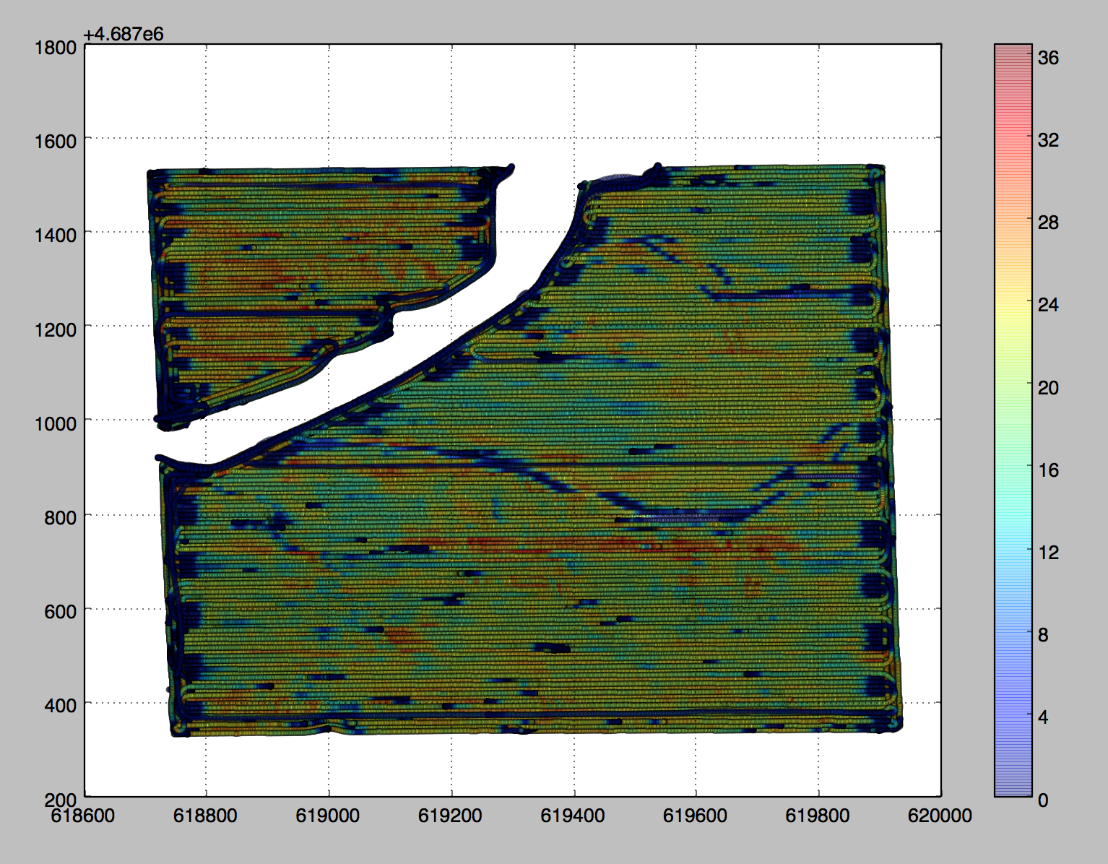
Notes:
There is a gradient/color bar which tells us what value of yield point on the yield map has.

Slide 7
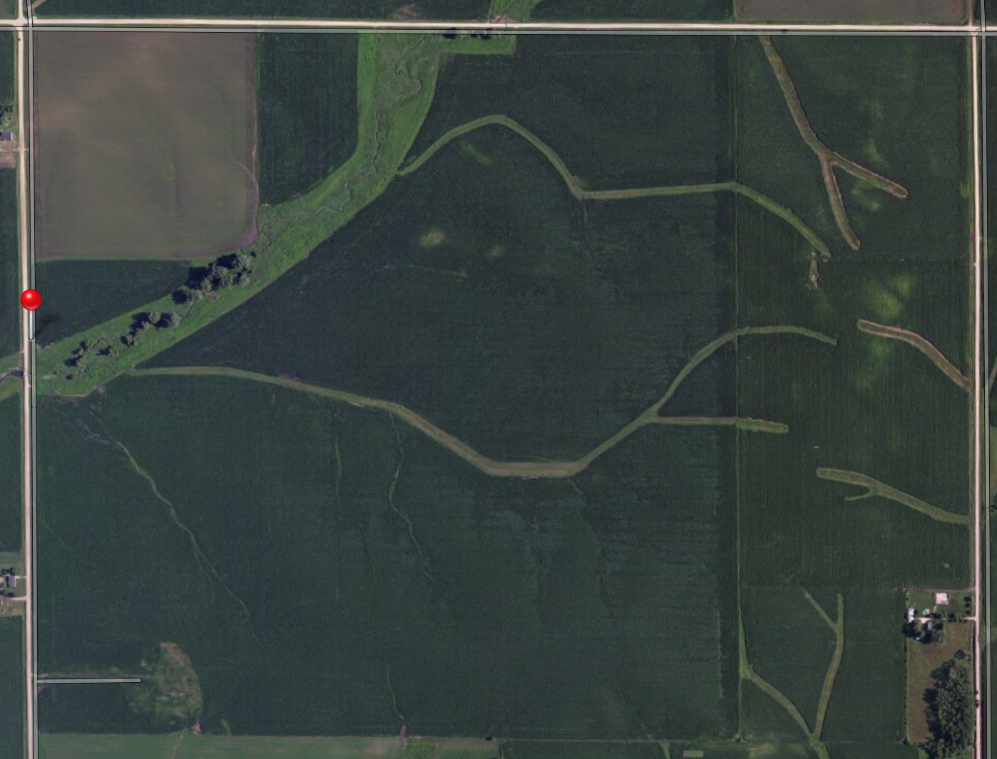
Notes:
This is the same field as seen on google maps

Slide 8
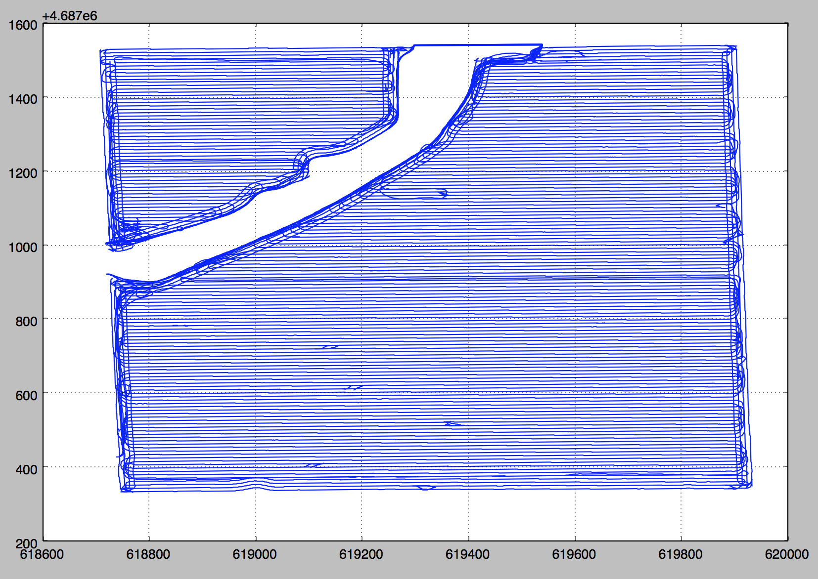
Notes:
Given the time stamps we are also able to show the exact path that the combine took on the field.

Slide 9
Data Analysis Step Two
Finding Critical Points:
Two Methods:
Direction Change
Zero Chains
Notes:
In order to estimate the error function we filter out certain critical values from the given data. These values correspond to the places where the combine is entering or exiting the field. Since there is zero corn harvested in these areas the yield being recorded starts to decay. We hope that by observing this decay curve we can get a better understanding of how the lag works. We developed several different approaches to find the Critical Points and experimented the methods with the Broghammer data but will present the two that worked out satisfactorily.

Slide 10
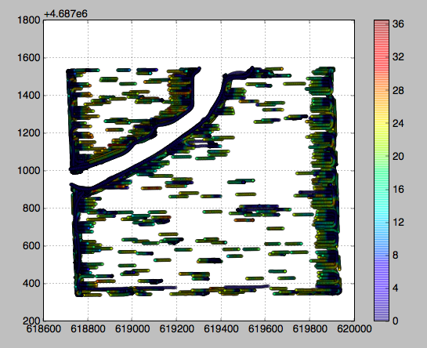
Method One
Direction Change
Notes:
By observing the path that the combine took we can see that whenever the combine exits the crop field it turns back around and re-enters. We try to take advantage of this fact by sampling sets values between points that had a significant direction change.
We scan over the data set in time order and compare the direction of the combine at a certain point to its direction n points later. If there is a significant (greater than some threshold) change in the direction then we record all the data points between the two points.

Slide 11
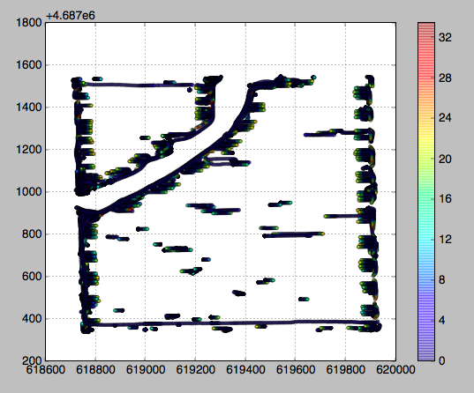
Method Two
Zero Chains
Notes:
This method worked out the best. In this method we scan over the data in the time order. While doing so we try to find chains of zeroes that are longer than a certain length. We then sample these zero points and also a certain number of points to the left and right of this chain (10 worked out well).

Slide 12
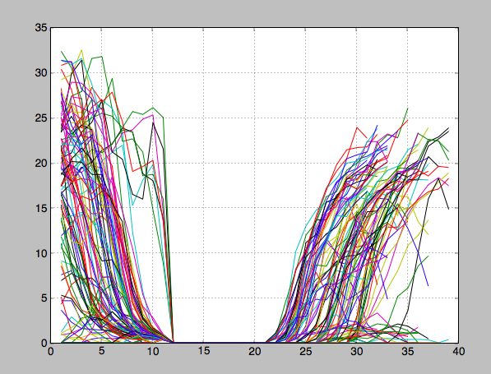
Data Analysis Step Three
Estimating Lag Function
Notes:
We have only generated some plots of the zero chains that were found. We used linear interpolation to draw these curves. We notice that all the curves decay to zero after the same number of points, however this is just an artifact of the way we filtered using the zero chains approach. The curves largely seem similar enough which gives us hope that we can find a consistent decay curve.

Slide 13
Curve Fitting and Plotting
Curve Fitting and Plotting Data
Tested the sampled points by performing 3rd, 4th, 6th, and 10th order polynomial fit.
Notes:
With the sample points extracted using the Zero Chains Method, I tested the critical points to create a lag function.
Since, the maximum length of the chain of sample points is 4000, I have truncated the length of the sample points to 40,60 then to 80 to focus on curve fitting the interval where the points are most populated. Tested the sampled points by performing 3rd, 4th, 6th, and 10th order polynomial fit.

Slide 14
Lag Function (3 combines)
Lag Function
Notes:
This is the lag function with chains length 40

Slide 15
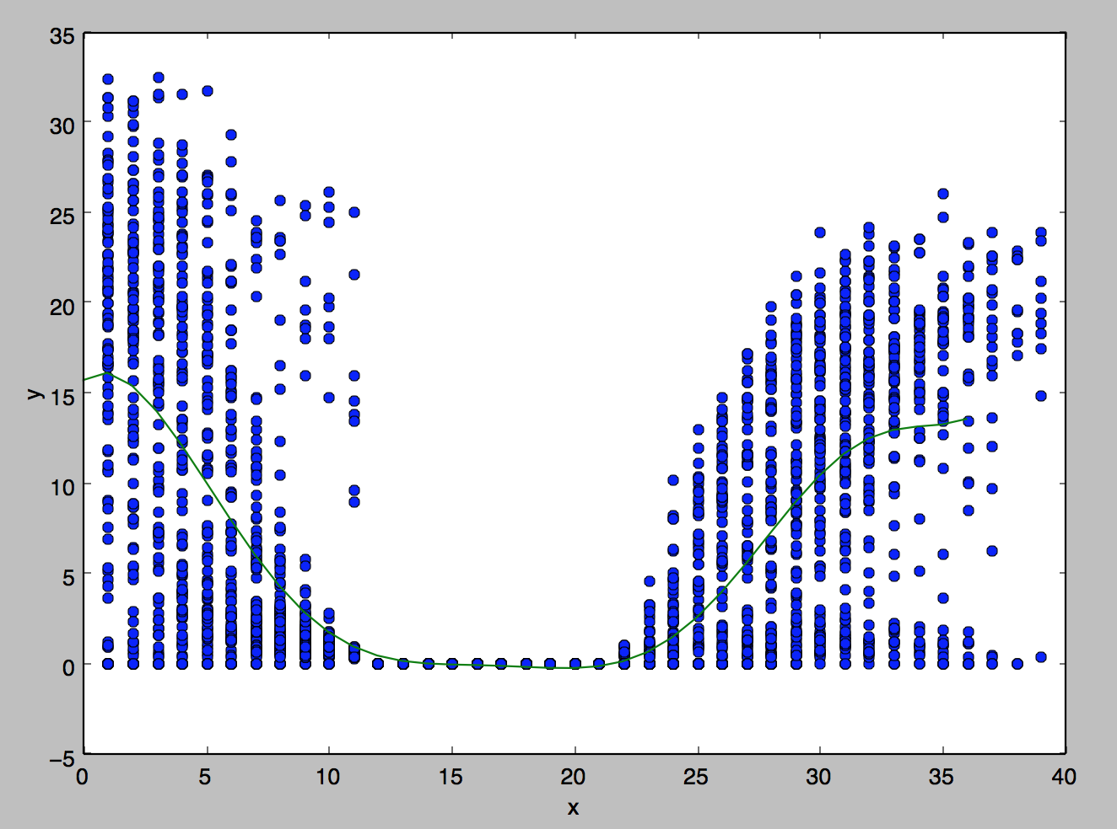
Notes:
Blue data represents the yield data of the critical points
The green line represents the fitted curve.

Slide 16
Data Analysis Step Four
Extract critical points, and find separate lag functions for each combine.

Slide 17
Lag Function
Combine 1
Combine 2
Combine 3

Slide 18
Program

